Slide 1
When ransomware attacks a school, you get detention
Dennis Labossiere
KPMG Cyber Response Services
September 13, 2022

Slide 2

Contents
01 | About me | 3
02 | W.I.I.F.M & Agenda | 5
03 | Investigation | 8
04 | Summary | 42
05 | Q&A | 44
06 | Thank you | 45

Slide 3

Who am I?
whoami
Dennis Labossiere
Manager within the KPMG Cyber Response Services practice
Experience.ps1 –degree All –years –certs
B.S. from Utica College (n.k.a. Utica University) in cybercrime forensics and investigations
M.S. from Utica College (n.k.a. Utica University) in cybersecurity; computer forensics and cyber operations
8 years of DFIR experience
SANS GCFE, GCFA (have taken other courses w/o certs)
Splunk Core Certified User
SentinelOne Incident Response Engineer (SIREN)
MITRE ATT&CK Defender (MAD) CTI and Adversary Emulation
Cyber_passions.ps1 –all
Ransomware investigations
Threat hunting & detection engineering
Personal.ps1 –all
Husband and a father
Former DIII collegiate baseball player
Glamor camper (camping with electric) that loves to fish and cook
This is my first conference presentation

Slide 4
What’s in it for me and agenda
01

Slide 5
W.I.I.F.M?
What’s in it for me?
We all have something to learn
Reminder to leverage all available telemetry
Think about what data points aside from host-based forensics can be leveraged
Refresh of some important attacker TTPs
Share a few stories from the trenches & have a laugh or two
Maybe learn a new technique or analytic skill

Slide 6
Agenda
Provide a background of the ransomware attack — code named Project Detention — detailing the who, what, and when
Describe the methodology and available telemetry that allowed the KPMG team to successfully investigate this incident
Discuss various attacker TTPs including but not limited to;
NTDS.DIT dumping
Anti-forensic behavior
Various methods used for data exfil
Overview how we re-wrote an attacker’s PowerShell script for our benefit to aid in determining what exactly was exfiltrated
Go over the TTPs (mapped to MITRE ATT&CK) and observables for this attack
NOTE: Where appropriate, redactions or implicit changes are made to protect our client’s identity.

Slide 7
Investigation background & methodology
02

Slide 8
Background
Attack timeframe
December 12, 2021 through December 17, 2021
Attribution
The ransom note named Vice Society and the ransomware was a strain of Zeppelin
Date/Time (UTC) | Event | Artifact source | Event ID (if applicable)
2021-12-14 10:40:37.200 | File "C:\Users\administrator\AppData\Local\Temp\2\svchost2.exe" detected as Zeppelin ransomware | Microsoft-Windows-Windows Defender%4Operational.evtx | 1116
Client information
Client is in the state & local government sector
NOTE: Where appropriate, redactions or changes to client information are made to protect their identity.

Slide 9
Methodology
Starting with the facts, we know ransomware was deployed but where do we start?
Start with where attackers frequently target, the high value targets (e.g., Domain Controllers, File servers, Exchange servers, etc.)
KPMG leverages our patented forensic triage collection tool; KPMG Digital Responder (“KDR”)
After triaging the high value targets, work on root cause analysis and lateral movement.
Divide the work into two workstreams, one works point-in-time forward and the other works point-in-time backwards
Look for lateral movement outside of normal business hours and look for quick wins (e.g., service installs, malicious PowerShell activity, scheduled task creations, etc.)
Leverage all available telemetry…what did we have?
Endpoint data (e.g., event logs, registry, user execution, etc.)
Network data (e.g., firewall logs)
EDR data
Identify compromised user accounts and their corresponding SIDs.
Track movement and associated activity (e.g., dumping creds, persistence attempts, etc.)
Document findings in a timeline format so the bigger picture comes together.
Do you see the forest through the trees?

Slide 10
Dumping credentials
03

Slide 11
Dumping user passwords
Attackers dump credentials using a number of methods (e.g., Mimikatz, LSASS, etc.) but have you seen attackers use the backup software Veeam?
We observed the attackers using the Veeam service account for interactive logins
SQL query1:
SELECT TOP (1000) [id],[user_name],[password],[usn],[description],[visible],[change_time_utc] FROM [VeeamBackup].[dbo].[Credentials]
PowerShell one-liners to decode the Veeam password
> Add-Type –Path “C:\Program Files\Veeam\Backup and Replication\Backup\Veeam.Backup.Common.dll”
> $encoded = ‘<encoded string>’
> [Veeam.Backup.Common.ProtectedStorage]::GetLocalString($encoded)
¹ https://forums.veeam.com/veeam-backup-replication-f2/recover-esxi-password-in-veeam-t34630.html

Slide 12
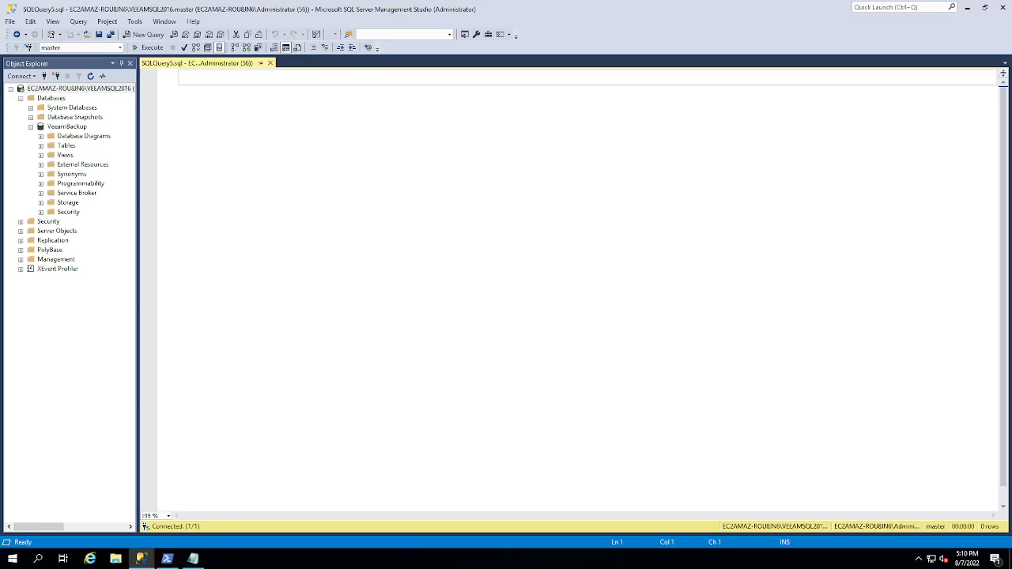

Slide 13
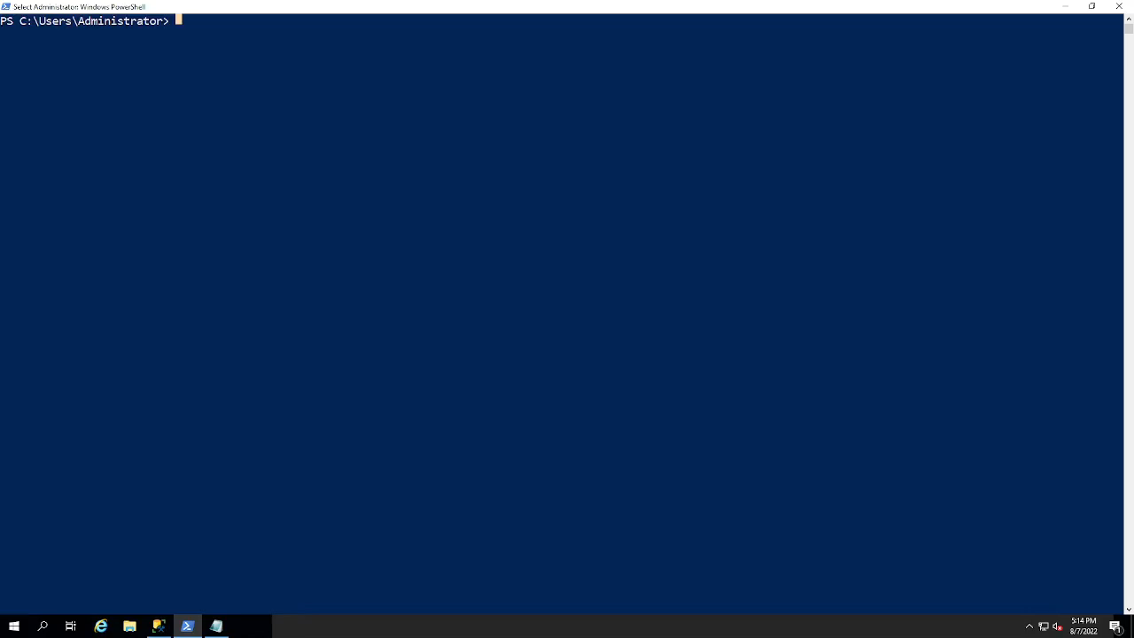

Slide 14
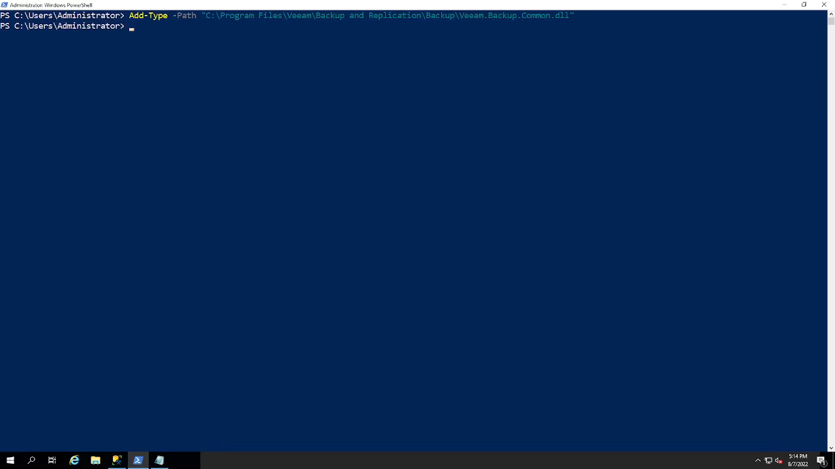

Slide 15
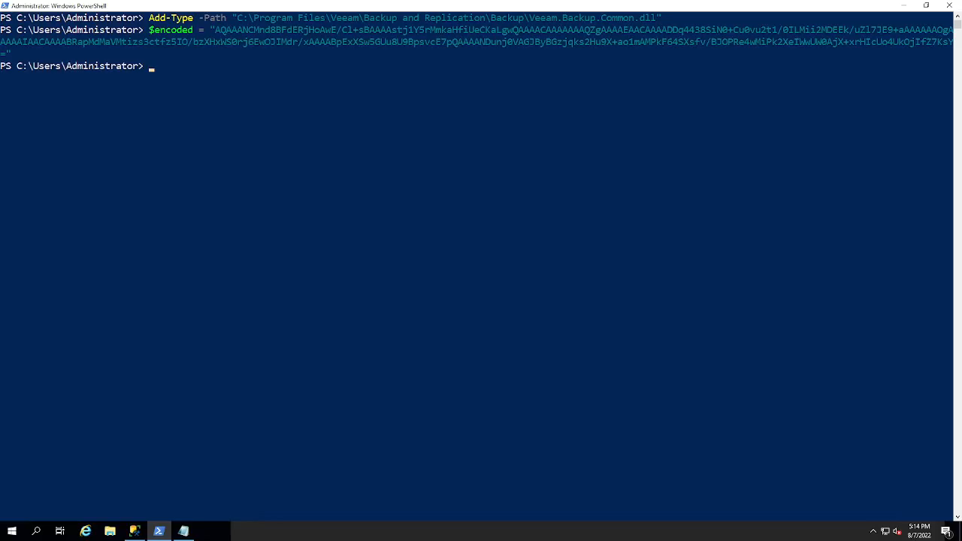

Slide 16
NTDS.DIT Dumping
Using ntdsutil in a PowerShell one-liner:
ntdsutil "ac i ntds" "ifm" "create full c:\users\public\Dump" q q
Date/Time (UTC) | Event | Artifact source | Event ID (if applicable)
2021-12-12 12:35:54.229 | C:\Windows\System32\wbem\WmiPrvSE.exe spawned C:\Windows\System32\cmd.exe | Security.evtx | 4688
2021-12-12 12:36:04.849 | C:\Windows\System32\cmd.exe spawned C:\Windows\System32\WindowsPowerShell\v1.0\powershell.exe | Security.evtx | 4688
2021-12-12 12:37:22.624 | C:\Windows\System32\WindowsPowerShell\v1.0\powershell.exe spawned C:\Windows\System32\quser.exe | Security.evtx | 4688
2021-12-12 12:38:42.842 | C:\Windows\System32\WindowsPowerShell\v1.0\powershell.exe spawned C:\Windows\System32\ntdsutil.exe | Security.evtx | 4688
2021-12-12 12:38:44.600 | Directories C:\Users\Public\l0gs\Active Directory & C:\Users\Public\l0gs\registry created | $UsnJrnl
2021-12-12 12:38:44.662 | C:\Windows\System32\services.exe spawned C:\Windows\System32\VSSVC.exe | Security.evtx | 4688
2021-12-12 12:38:52.866 | File C:\Users\Public\l0gs\Active Directory\ntds.dit created | $UsnJrnl
2021-12-12 12:38:53.381 | File “NTDS.DIT” dumped to C:\Users\Public\l0gs\Active Directory | Application.evtx | 325¹
2021-12-12 12:38:53.382 | File C:\Users\Public\l0gs\registry\SYSTEM created | $MFT
2021-12-12 12:39:04.194 | File C:\Users\Public\l0gs\registry\SECURITY created | $MFT
2021-12-12 12:39:32.771 | C:\Windows\System32\WindowsPowerShell\v1.0\powershell.exe spawned C:\Windows\System32\ntdsutil.exe | Security.evtx | 4688
2021-12-12 12:40:10.712 | File C:\Users\Public\l0gs\Active Directory\ntds.dit deleted | $UsnJrnl
2021-12-12 12:40:10.728 | Files C:\Users\Public\l0gs\registry\SYSTEM, C:\Users\Public\l0gs\registry\SECURITY & directory C:\Users\Public\l0gs\registry deleted | $UsnJrnl
2021-12-12 12:55:06.000 | Directory C:\Users\Public\Dump opened | Shellbags
2021-12-12 12:55:12.556 | File “NTDS.DIT” dumped to C:\Users\Public\Dump\Active Directory | Application.evtx | 325
2021-12-12 12:55:51.774 | File C:\Users\Administrator\Desktop\Dump.lnk created | LNK Files
2021-12-12 12:56:05.000 | File C:\Users\Administrator\Desktop\Dump.zip opened | RecentDocs
¹ 13Cubed episode: Detecting NTDS.DIT Theft — ESENT Event Logs by Richard Davis
Notes:
Video dropped Dec 23, 2021 on YouTube.

Slide 17
NTDS.DIT Dumping
Date/Time (UTC) | Event | Artifact source | Event ID (if applicable)
2021-12-12 12:35:54.229 | C:\Windows\System32\wbem\WmiPrvSE.exe spawned C:\Windows\System32\cmd.exe | Security.evtx | 4688
2021-12-12 12:36:04.849 | C:\Windows\System32\cmd.exe spawned C:\Windows\System32\WindowsPowerShell\v1.0\powershell.exe | Security.evtx | 4688
2021-12-12 12:37:22.624 | C:\Windows\System32\WindowsPowerShell\v1.0\powershell.exe spawned C:\Windows\System32\quser.exe | Security.evtx | 4688
2021-12-12 12:38:42.842 | C:\Windows\System32\WindowsPowerShell\v1.0\powershell.exe spawned C:\Windows\System32\ntdsutil.exe | Security.evtx | 4688
2021-12-12 12:38:44.600 | Directories C:\Users\Public\l0gs\Active Directory & C:\Users\Public\l0gs\registry created | $UsnJrnl
2021-12-12 12:38:44.662 | C:\Windows\System32\services.exe spawned C:\Windows\System32\VSSVC.exe | Security.evtx | 4688
2021-12-12 12:38:52.866 | File C:\Users\Public\l0gs\Active Directory\ntds.dit created | $UsnJrnl
2021-12-12 12:38:53.381 | File “NTDS.DIT” dumped to C:\Users\Public\l0gs\Active Directory | Application.evtx | 325¹
2021-12-12 12:38:53.382 | File C:\Users\Public\l0gs\registry\SYSTEM created | $MFT
2021-12-12 12:39:04.194 | File C:\Users\Public\l0gs\registry\SECURITY created | $MFT
2021-12-12 12:39:32.771 | C:\Windows\System32\WindowsPowerShell\v1.0\powershell.exe spawned C:\Windows\System32\ntdsutil.exe | Security.evtx | 4688
2021-12-12 12:40:10.712 | File C:\Users\Public\l0gs\Active Directory\ntds.dit deleted | $UsnJrnl
2021-12-12 12:40:10.728 | Files C:\Users\Public\l0gs\registry\SYSTEM, C:\Users\Public\l0gs\registry\SECURITY & directory C:\Users\Public\l0gs\registry deleted | $UsnJrnl
2021-12-12 12:55:06.000 | Directory C:\Users\Public\Dump opened | Shellbags
2021-12-12 12:55:12.556 | File “NTDS.DIT” dumped to C:\Users\Public\Dump\Active Directory | Application.evtx | 325
2021-12-12 12:55:51.774 | File C:\Users\Administrator\Desktop\Dump.lnk created | LNK Files
2021-12-12 12:56:05.000 | File C:\Users\Administrator\Desktop\Dump.zip opened | RecentDocs
¹ 13Cubed episode: Detecting NTDS.DIT Theft — ESENT Event Logs by Richard Davis
Notes:
Video dropped Dec 23, 2021 on YouTube.

Slide 18
Anti-forensic behavior
04

Slide 19
Anti-forensic behavior — Bypassing Windows Defender
PowerShell one-liners to disable Windows Defender via Registry
reg delete "HKLM\Software\Policies\Microsoft\Windows Defender” /f​​
reg add "HKLM\Software\Policies\Microsoft\Windows Defender" /v "DisableAntiSpyware" /t REG_DWORD /d "1" /f​
reg add "HKLM\Software\Policies\Microsoft\Windows Defender" /v "DisableAntiVirus" /t REG_DWORD /d "1" /f​
reg add "HKLM\Software\Policies\Microsoft\Windows Defender\MpEngine" /v "MpEnablePus" /t REG_DWORD /d "0" /f​
reg add "HKLM\Software\Policies\Microsoft\Windows Defender\Real-Time Protection" /v "DisableBehaviorMonitoring" /t REG_DWORD /d "1" /f​
Microsoft-Windows-Windows Defender%4Operation.evtx¹
EID 5001 — Microsoft Defender Antivirus real-time protection scanning for malware and other potentially unwanted software was disabled
EID 5010 — Microsoft Defender Antivirus scanning for malware and other potentially unwanted software is disabled
EID 5012 — Microsoft Defender Antivirus scanning for viruses is disabled
¹ https://docs.microsoft.com/en-us/microsoft-365/security/defender-endpoint/troubleshoot-microsoft-defender-antivirus?view=o365-worldwide​

Slide 20
Anti-forensic behavior — Clearing event logs
The attackers leveraged a command technique to cover their tracks
We were only able to see the commands entered (below) thanks to a few systems having Sysmon, otherwise, our only evidence would have been an entry in the logs stating they were cleared.
wevtutil cl security
wevtutil cl system
wevtutil cl application

Slide 21
Data exfiltration analysis
05

Slide 22

Let’s talk exfiltration
One of the most important topics when we perform investigations is exfiltration…
Did exfiltration occur? Is there proof (without engaging the threat actor/negotiating)
What was taken? Is there proof (again, without engaging the threat actor/negotiating)
If we have proof, what’s next?
Inform outside counsel
If one exists, check the leak site
Sometimes, as in this case, the data on the leak site was not 100% of what we know was exfiltrated
Perform additional analysis to determine the common questions; what? when? where? how?
Lucky for us, the threat actor made this very easy…

Slide 23
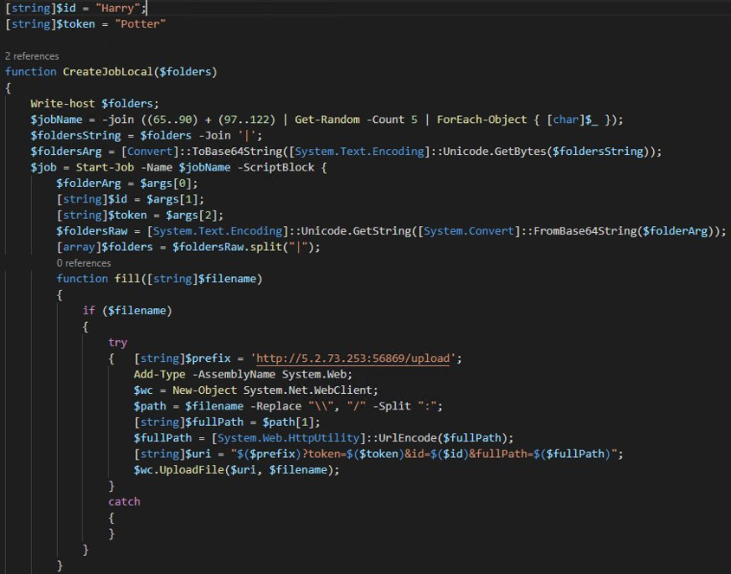
PowerShell script analysis
The first 34 lines are shown:
Attackers hardcoded an IP; 5[.]2.73.253
Used an ID and a token (Harry & Potter) as an argument for uploading
Attackers replaced Windows UNC pathing in favor of Linux pathing and split on colons

Slide 25
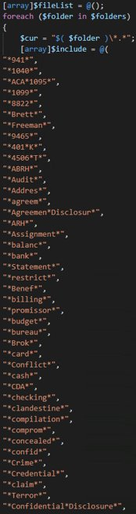
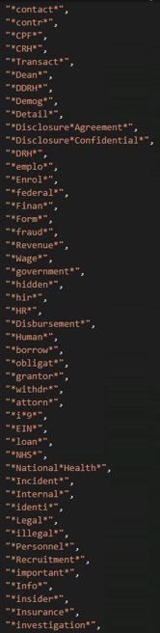
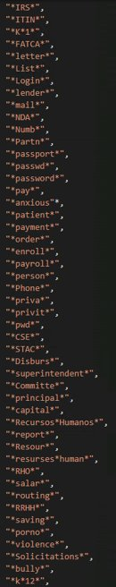
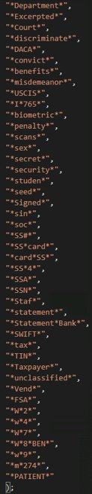
PowerShell script analysis (continued)
The list on the right is a subset of the file names the attackers were looking for on every system this script was executed on
Looked for blackmail and/or sensitive information on victims
Most keywords were in English, some were in Spanish (e.g., Human Resources vs. Recursos Humanos)

Slide 27
Data exfil analysis
The following two slides list the systems identified through the available Palo Alto firewall logs.
The identification occurred as a result of looking for any connections to the IP found within the attacker’s PowerShell script.
The results are all successful connections to the attacker’s IP.
Palo Alto firewall query:
((receive_time geq '2021/12/11 00:00:00') and (receive_time leq '2021/12/16 00:00:00')) and ((addr.dst in 5.2.73.253) or (addr.dst in 146.70.44.168))

Slide 28
Data exfil analysis — Firewall
# | Hostname | Destination IP Address | Firewall (First Seen UTC) | PowerShell Script (First Seen UTC) | Firewall (Last Seen UTC) | PowerShell Script (Last Seen UTC) | Total Bytes Sent | Total GB Sent
1 | SERVER-0144 | 5.2.73.253 | 2021-12-14 04:10:06 | 2021-12-14 03:50:24 | 2021-12-14 04:19:57 | 2021-12-14 10:39:52 | 138270​ | 0.00013
2 | FILESEVER1 | 5.2.73.253 | 2021-12-14 04:10:31 | No forensic evidence​ | 2021-12-14 11:12:32 | No forensic evidence​ | 31465669618​ | 29.30469
3 | BACKUP5 | 5.2.73.253 | 2021-12-14 05:12:17 | 2021-12-12 23:54:04 | 2021-12-14 04:15:41 | 2021-12-14 10:41:36 | 341489180​ | 0.31804
4 | STI | 5.2.73.253 | 2021-12-14 05:12:23 | No forensic evidence​ | 2021-12-14 05:14:00 | No forensic evidence​ | 15610040​ | 0.01454
5 | BACKUP6 | 5.2.73.253 | 2021-12-14 05:12:30 | 2021-12-14 11:59:50 | 2021-12-14 12:09:38 | 2021-12-14 12:05:02 | 335698771287​ | 312.64384
6 | SISFIN2 | 5.2.73.253 | 2021-12-14 05:12:41 | 2021-12-13 00:07:20 | 2021-12-14 05:13:09 | 2021-12-14 05:12:38 | 32242588​ | 0.03003
7 | SCCM2 | 5.2.73.253 | 2021-12-14 05:12:42 | 2021-12-14 05:57:16 | 2021-12-14 08:28:28 | 2021-12-14 05:58:17 | 85850468297​ | 79.95448
8 | ADATA | 5.2.73.253 | 2021-12-14 05:12:44 | 2021-12-12 23:54:00 | 2021-12-14 05:17:25 | 2021-12-14 05:16:53 | 839041583​ | 0.78142
9 | VERSA2 | 5.2.73.253 | 2021-12-14 05:12:48 | 2021-12-13 00:03:25 | 2021-12-14 05:14:42 | 2021-12-14 05:13:10 | 93352567​ | 0.08694
10 | VERSA | 5.2.73.253 | 2021-12-14 05:12:48 | 2021-12-13 00:02:13 | 2021-12-14 05:14:14 | 2021-12-14 05:13:44 | 11983569​ | 0.01116
11 | SERVER1 | 5.2.73.253 | 2021-12-14 05:12:48 | 2021-12-12 23:59:50 | 2021-12-14 05:23:34 | 2021-12-14 05:22:40 | 223691364​ | 0.20833
12 | BACKUP1 | 5.2.73.253 | 2021-12-14 05:12:49 | 2021-12-12 23:53:20 | 2021-12-14 05:14:09 | 2021-12-14 05:12:23 | 86491614​ | 0.08055
13 | ADAUDIT | 5.2.73.253 | 2021-12-14 05:12:52 | 2021-12-12 23:53:59 | 2021-12-14 05:22:30 | 2021-12-14 05:21:21 | 1028735694​ | 0.95808
14 | REMOTEAPP1 | 5.2.73.253 | 2021-12-14 05:12:53 | 2021-12-12 14:08:52 | 2021-12-14 05:13:10 | 2021-12-14 05:12:39 | 3513442​ | 0.00327
15 | ADFS1 | 5.2.73.253 | 2021-12-14 05:12:54 | No forensic evidence​ | 2021-12-14 05:16:03 | No forensic evidence​ | 67049214​ | 0.06244
16 | SQL1 | 5.2.73.253 | 2021-12-14 05:12:54 | 2021-12-12 23:54:43 | 2021-12-14 05:23:10 | 2021-12-14 05:22:14 | 236839148​ | 0.22057
17 | EXCHANGE3 | 5.2.73.253 | 2021-12-14 05:12:56 | 2021-12-13 00:07:29 | 2021-12-14 05:19:30 | 2021-12-14 05:11:58 | 420290173​ | 0.39143
18 | DNS01 | 5.2.73.253 | 2021-12-14 05:13:04 | 2021-12-12 23:53:01 | 2021-12-14 05:13:04 | 2021-12-14 05:12:35 | 3166310​ | 0.00295
19 | EXCHANGE4 | 5.2.73.253 | 2021-12-14 05:13:07 | 2021-12-13 00:02:48 | 2021-12-14 05:25:16 | 2021-12-14 05:20:08 | 668427226​ | 0.62252
20 | AVTECH | 5.2.73.253 | 2021-12-14 05:13:09 | No forensic evidence​ | 2021-12-14 05:13:18 | No forensic evidence​ | 1123483​ | 0.00105
21 | EXCHANGE5 | 5.2.73.253 | 2021-12-14 05:13:15 | No forensic evidence​ | 2021-12-14 05:23:27 | No forensic evidence​ | 444577868​ | 0.41405

Slide 29
Data exfil analysis — Firewall (continued)
# | Hostname | Destination IP Address | Firewall (First Seen UTC) | PowerShell Script (First Seen UTC) | Firewall (Last Seen UTC) | PowerShell Script (Last Seen UTC) | Total Bytes Sent | Total GB Sent
22 | GATESERVER | 5.2.73.253 | 2021-12-14 05:13:18 | 2021-12-13 06:00:12 | 2021-12-14 05:26:34 | 2021-12-14 11:23:45 | 189850121 | 0.17681
23 | SISSERVER1 | 5.2.73.253 | 2021-12-14 05:13:22 | 2021-12-13 06:02:09 | 2021-12-14 05:14:11 | 2021-12-14 11:13:13 | 58263174 | 0.05426
24 | DESIGO | 5.2.73.253 | 2021-12-14 05:13:26 | 2021-12-14 11:58:06 | 2021-12-14 08:18:48 | 2021-12-14 12:00:31 | 30060275513 | 27.99581
25 | SERVERDA | 5.2.73.253 | 2021-12-14 05:13:27 | 2021-12-13 05:53:28 | 2021-12-14 05:13:44 | 2021-12-14 11:13:20 | 39816184 | 0.03708
26 | AD01 | 5.2.73.253 | 2021-12-14 05:13:44 | 2021-12-14 11:11:57 | 2021-12-14 05:21:58 | 2021-12-14 11:21:03 | 361198905 | 0.33639
27 | DFS1 | 5.2.73.253 | 2021-12-14 05:13:50 | 2021-12-13 05:52:52 | 2021-12-14 12:04:05 | 2021-12-14 11:42:39 | 274493145853 | 255.64166
28 | BACKUP | 5.2.73.253 | 2021-12-14 05:13:54 | No forensic evidence | 2021-12-14 05:19:22 | No forensic evidence | 3204 | 0.00000
29 | AD02 | 5.2.73.253 | 2021-12-14 05:13:56 | 2021-12-13 05:51:46 | 2021-12-14 05:13:57 | 2021-12-14 11:12:50 | 47626243 | 0.04436
30 | SERVER2 | 5.2.73.253 | 2021-12-14 05:14:00 | 2021-12-13 05:57:48 | 2021-12-14 06:43:31 | 2021-12-14 12:00:07 | 34311956001 | 31.95550
31 | WSUS | 5.2.73.253 | 2021-12-14 05:14:13 | 2021-12-13 05:53:24 | 2021-12-14 05:39:03 | 2021-12-14 11:11:58 | 180057998 | 0.16769
32 | NVR-9 | 5.2.73.253 | 2021-12-14 05:14:14 | 2021-12-14 16:54:14 | 2021-12-14 05:32:10 | 2021-12-14 16:54:14 | 19740 | 0.00002
33 | NVR-8 | 5.2.73.253 | 2021-12-14 05:14:39 | 2021-12-14 11:42:31 | 2021-12-14 05:57:44 | 2021-12-14 16:54:33 | 70428 | 0.00007
34 | NVR-5 | 5.2.73.253 | 2021-12-14 05:14:59 | No forensic evidence | 2021-12-14 05:25:37 | No forensic evidence | 19926 | 0.00002
35 | NVR-7 | 5.2.73.253 | 2021-12-14 05:15:02 | 2021-12-14 11:41:06 | 2021-12-14 05:55:09 | 2021-12-14 16:51:38 | 82254 | 0.00008
36 | PRINTSERVER | 5.2.73.253 | 2021-12-14 05:15:10 | 2021-12-13 06:06:28 | 2021-12-14 05:17:13 | 2021-12-14 11:15:55 | 62628095 | 0.05833
37 | NVR-6 | 5.2.73.253 | 2021-12-14 05:15:28 | 2021-12-14 11:25:05 | 2021-12-14 05:43:30 | 2021-12-14 16:40:40 | 68946 | 0.00006
38 | SPICE2 | 5.2.73.253 | 2021-12-14 05:15:41 | 2021-12-13 05:54:04 | 2021-12-14 05:15:56 | 2021-12-14 11:15:26 | 3464355 | 0.00323
39 | SPICE1 | 5.2.73.253 | 2021-12-14 05:15:52 | 2021-12-13 05:54:04 | 2021-12-14 05:15:52 | 2021-12-14 11:18:22 | 179768753 | 0.16742
40 | TREND | 5.2.73.253 | 2021-12-14 05:16:11 | 2021-12-13 05:53:50 | 2021-12-14 05:20:31 | 2021-12-14 11:16:21 | 111650581 | 0.10398
41 | BACKUP2 | 5.2.73.253 | 2021-12-14 05:17:26 | 2021-12-13 05:54:08 | 2021-12-14 05:17:54 | 2021-12-14 11:17:19 | 59151932 | 0.05509

Slide 30
Data exfil analysis — MEGA
Event Start Time (UTC) | Bytes Sent | MB Sent
2021-12-14 02:43:51.000 | 376548286 | 359.1044292
2021-12-14 02:43:51.000 | 2286 | 0.002180099
2021-12-14 02:43:52.000 | 427905739 | 408.0827131
2021-12-14 02:43:52.000 | 377790020 | 360.2886391
2021-12-14 02:58:27.000 | 2254 | 0.002149582
2021-12-14 04:23:59.000 | 3147 | 0.003001213
2021-12-14 04:23:59.000 | 2006 | 0.001913071
2021-12-14 04:23:59.000 | 870 | 0.000829697
2021-12-14 04:23:59.000 | 866 | 0.000825882
2021-12-14 04:25:41.000 | 3327 | 0.003172874
2021-12-14 04:25:41.000 | 2246 | 0.002141953
MEGA activity identified through host and firewall log analysis
MEGA logs located on EXCHANGE3: C:\Users\administrator\AppData\Local\Mega Limited\MEGAsync\logs
Approximately 73GB exfiltrated through MEGA through three (3) systems
EXCHANGE3 had ~ 65GB exfiltrated
BACKUP5 had ~ 7GB exfiltrated
FILESERVER1 had ~ 50MB exfiltrated
Palo Alto firewall query:
((receive_time geq '2021/12/11 00:00:00') and (receive_time leq '2021/12/17 00:00:00')) and ((app eq mega) or (app eq mega-base) or (app eq megachat) or (app eq megaproxy) or (app eq megashare) or (app eq megashares) or (app eq megaupload) or (app eq megavideo))

Slide 31
Data exfil analysis — MEGA (continued)
14 employee PSTs were collected and exfiltrated via MEGA
PowerShell one liner to dump this information (ran by attackers)
New-MailboxExport Request –ContentFilter “(Received –lt ‘06/27/2020’) –and (Received –gt ‘01/01/2020’)” –Mailbox “<USERNAME>” –FilePath “C:\Users\<USER>\AppData\Local\Temp\3\Newfolder\<filename>.pst”
Date/Time (UTC) | Event | Artifact source | Event ID (if applicable)
2021-12-14 03:22:52.000 | Program "C:\Windows\System32\WindowsPowerShell\v1.0\PowerShell.exe" executed | UserAssist | NTUSER.DAT
2021-12-14 03:27:14.695 | File "C:\Users\ITUser\Downloads\MEGAsyncSetup64.exe" created | $MFT
2021-12-14 03:31:27.000 | Dumped user PST file to "C:\Users\ITUser\AppData\Local\Temp\3\Newfolder" | MSExchange Management.evtx | 6
2021-12-14 03:31:27.000 | Dumped user PST file to "C:\Users\ITUser\AppData\Local\Temp\3\Newfolder" | MSExchange Management.evtx | 6
2021-12-14 03:31:45.000 | Dumped user PST file to "C:\Users\ITUser\AppData\Local\Temp\3\Newfolder" | MSExchange Management.evtx | 6
2021-12-14 03:31:45.000 | Dumped user PST file to "C:\Users\ITUser\AppData\Local\Temp\3\Newfolder" | MSExchange Management.evtx | 6
2021-12-14 03:32:12.000 | Dumped user PST file to "C:\Users\ITUser\AppData\Local\Temp\3\Newfolder" | MSExchange Management.evtx | 6
2021-12-14 03:32:12.000 | Dumped user PST file to "C:\Users\ITUser\AppData\Local\Temp\3\Newfolder" | MSExchange Management.evtx | 6

Slide 32
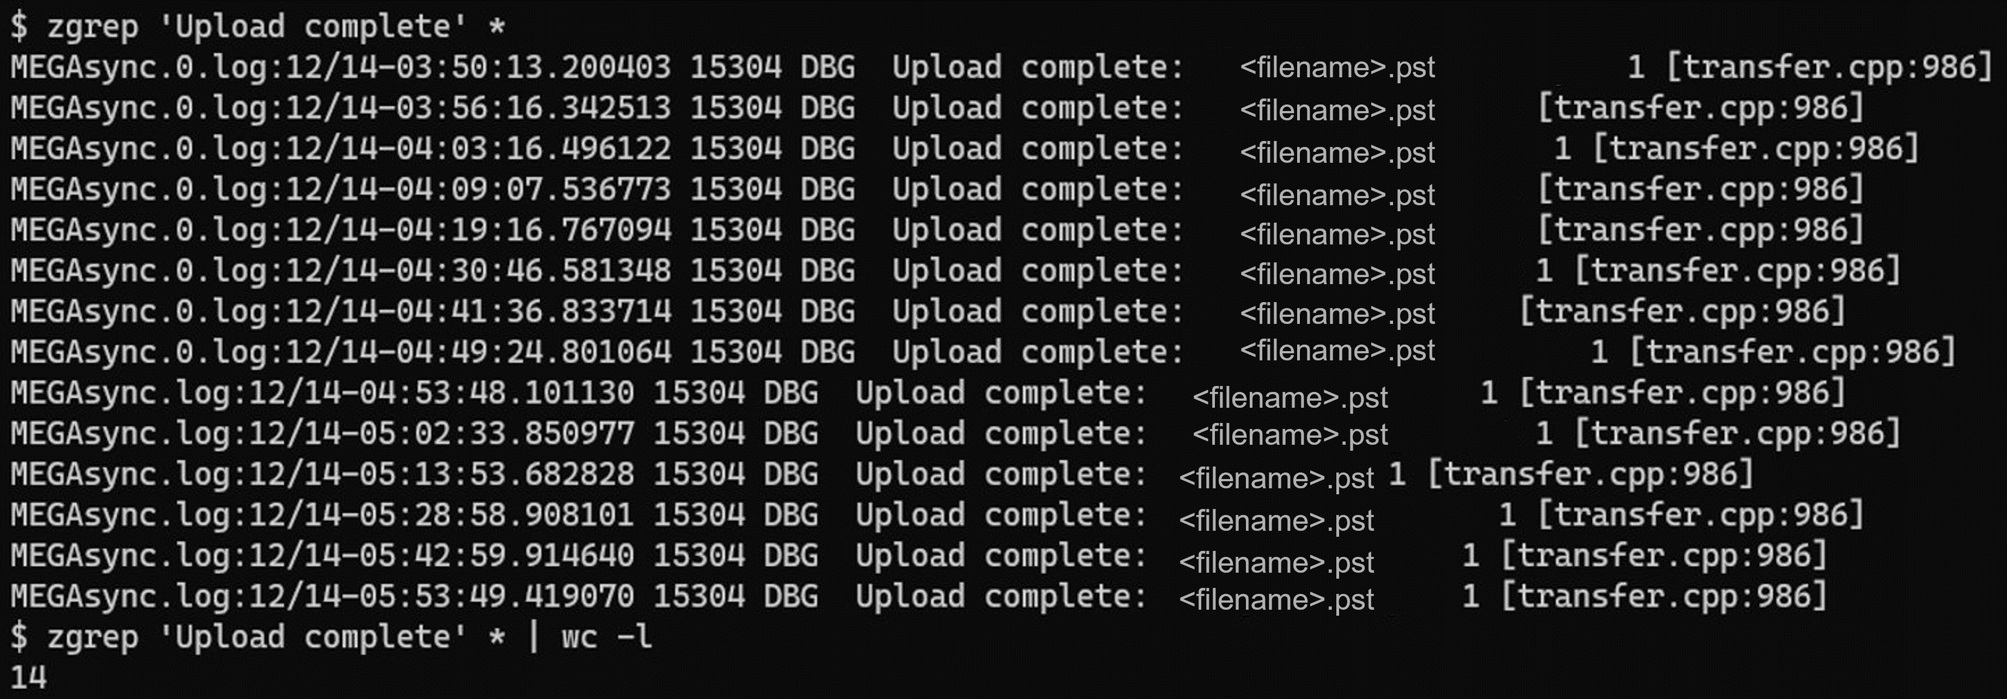
Data exfil analysis — MEGA (continued)
Location of MEGA logs: C:\Users\<USER>\AppData\Local\Mega Limited\MEGAsync\logs
Using Linux (WSL), the following command made for quick work of the logs
zgrep ‘Upload complete’ *
https://blog.reconinfosec.com/megasync-analysis/

Slide 33
Data exfil analysis — MEGA (continued)
https://blog.reconinfosec.com/megasync-analysis/

Slide 34
PowerShell script reversal
06

Slide 35
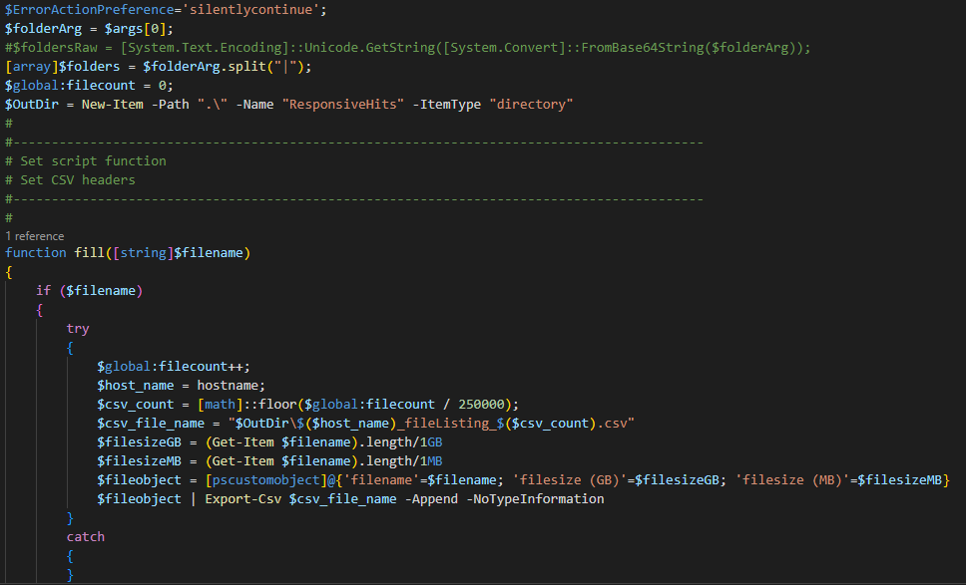
PowerShell script reversal
We were tasked with understanding what files were exfiltrated by the attackers specifically
After consulting with Outside Counsel, we reversed the script to work for us
We removed the hardcoded IP (for obvious reasons)
We refactored the code and performed some code tidying
We wrote all hits to a CSV file (per system) to be able to provide results to the client and Counsel

Slide 36
PowerShell script reversal
Attackers

Slide 37
PowerShell script reversal
Ours

Slide 38
MITRE ATT&CK mapping
07
MITRE ATT&CK mapping

Slide 39
MITRE ATT&CK mapping — found in presentation
Slide 8 — Masquerading: Match Legitimate Name or Location (T1036.005)
Slide 11 — Command and Scripting Interpreter: PowerShell (T1059.001)
Slide 16 — Command and Scripting Interpreter: Windows Command Shell (T1059.003)
Slide 16 — Command and Scripting Interpreter: PowerShell (T1059.001)
Slide 16 — OS Credential Dumping: NTDS (T1003.003)
Slide 18 — Command and Scripting Interpreter: PowerShell (T1059.001)
Slide 18 — Modify Registry (T1112)
Slide 18 — Impair Defenses: Disable or Modify Tools (T1562.001)
Slide 19 — Command and Scripting Interpreter: Windows Command Shell (T1059.003)
Slide 19 — Indicator Removal on Host: Clear Windows Event Logs (T1070.001)
Slide 22 — Command and Scripting Interpreter: PowerShell (T1059.001)
Slide 22 — Automated Collection (T1119)
Slide 22 — Data from Local System (T1005)
Slide 22 — Data from Network Shared Drive (T1039)
Slide 22 — Data Staged: Local Data Staging (T1074.001)
Slide 22 — Exfiltration Over Alternative Protocol: Exfiltration Over Unencrypted Non-C2 Protocol (T1048.003)
Slides 27 & 28 — Exfiltration Over Alternative Protocol: Exfiltration Over Unencrypted Non-C2 Protocol (T1048.003)
Slide 31 — Command and Scripting Interpreter: PowerShell (T1059.001)
Slide 31 — Data Staged: Local Data Staging (T1074.001)
Slide 31 — Exfiltration Over Web Service: Exfiltration to Cloud Storage (T1567.002)
Slide 32 — Exfiltration Over Web Service: Exfiltration to Cloud Storage (T1567.002)

Slide 40

MITRE ATT&CK mapping — observed during analysis
Valid Accounts: Domain Accounts (T1078.002)
User Execution: Malicious File (T1204.002)
Boot or Logon Autostart Execution: Registry Run Keys/Startup Folder (T1547.001)
Create or Modify System Process: Windows Service (T154.003)
Scheduled Task/Job: Scheduled Task (T1053.005)
System Services: Service Execution (T1569.002)
Create Account: Domain Account (T1136.002)
System Owner/User Discovery (T1033)
File and Directory Discovery (T1083)
Remote Services: Remote Desktop Protocol (T1021.001)
Remote Services: Windows Remote Management (T1021.006)
Ingress Tool Transfer (T1105)
Data Destruction (T1485)
Endpoint Denial of Service: Application or System Exploitation (T1499.004)
Note: Does not include execution of Invoke-SessionGopher or PowerSploit

Slide 41
MITRE ATT&CK mapping (continued)

Slide 42
Summary
08

Slide 43
Observables and IOCs
# | IOC | IOC Type | Path (if applicable)
1 | !!! ALL YOUR FILES ARE ENCRYPTED !!!.TXT | Ransom Note | N/A
2 | adobe.exe | Ransom binary | C:\Windows\Temp
3 | svchost.exe | Ransom binary | C:\Users\administrator\AppData\Roaming\Adobe\Flash Player
4 | svchost2.exe | Ransom binary | C:\Users\administrator\AppData\Local\Temp\3
5 | .v-society.1C8-69C-59A | Ransom extension | N/A
6 | psexec.exe | Admin tool | C:\Users\administrator\AppData\Local\Temp\3 C:\Windows C:\s$
7 | wow64 | Scheduled Task | C:\Windows\System32\Tasks
8 | w.ps1 OR p.ps1 | PowerShell exfil script | <HOST>\s$
9 | Advanced Port Scanner.exe | Reconnaissance | C:\Users\administrator\Desktop C:\Users\Anon\Desktop
10 | sg.zip | File | C:\Users\Public
11 | sg.txt | File | C:\Users\Public
12 | 0.bat | Batch file | C:\Users\Public
13 | Dump.zip | File | C:\Users\Administrator\Desktop
14 | Megasync | Scheduled Task | C:\Windows\System32\Tasks
15 | 5[.]2.73.253 | IP | N/A
16 | 146[.]70.44.168 | IP | N/A

Slide 44

Wrap-up
Provided a background of the ransomware attack — code named Project Detention — detailing the who, what, and when
Described the methodology and available telemetry that allowed the KPMG team to successfully investigate this incident
Discussed various attacker TTPs including but not limited to;
NTDS.DIT dumping,
Anti-forensic behavior
Various methods used for data exfil
Overviewed how we re-wrote an attacker’s PowerShell script for our benefit to aid in determining what exactly was exfiltrated
Went over the TTPs (mapped to MITRE ATT&CK) and observables for this attack

Slide 45
Questions
09

Slide 46
Thank you
10

Slide 47

Thank you
Goes without saying but I want to give a huge shoutout to my wife and family for the words of encouragement and support during this process.
I would like to thank my KPMG family and those that worked this project with me. A lot of their work was leveraged for this presentation and without them, this would not be possible.
Of course the KPMG Cyber Response partners for giving their blessings and their support with this endeavor.
Last but not least, my mentors for their guidance and support.

Slide 48
Thank you
Dennis Labossiere
Manager
KPMG Cyber Response Services
dlabossiere@kpmg.com Twitter: @dlabos https://www.linkedin.com/in/dennisleolabossiere/
About KPMG Cyber Response Services
We help clients effectively and efficiently prepare for and respond to cyber incidents.
Our experienced team of digital forensics and incident response professionals assist in forensic analysis, digital investigations as well as breach preparation.
Our proactive consulting services include:
Incident Response Plan and playbook development
Incident response maturity assessments
Cloud incident response orchestration & automation
Cloud digital forensic lab development

Slide 49
Some or all of the services described herein may not be permissible for KPMG audit clients and their affiliates or related entities.
kpmg.com/socialmedia
The information contained herein is of a general nature and is not intended to address the circumstances of any particular individual or entity. Although we endeavor to provide accurate and timely information, there can be no guarantee that such information is accurate as of the date it is received or that it will continue to be accurate in the future. No one should act upon such information without appropriate professional advice after a thorough examination of the particular situation.
© 2022 KPMG LLP, a Delaware limited liability partnership and a member firm of the KPMG global organization of independent member firms affiliated with KPMG International Limited, a private English company limited by guarantee. All rights reserved. NDP373090-1A
The KPMG name and logo are trademarks used under license by the independent member firms of the KPMG global organization.

